Slide 1
Multiplication à la Russe Algorithm

Slide 2
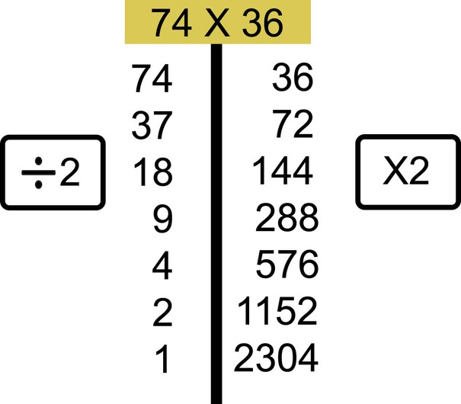
How it works
Write the problem on the top and make a column under each of the numbers of the problem. Every time you half the number on the left and double the number on the right. when you need to half an odd number take out 1 so it is even and half it. We will talk about what remains in a minute.

Slide 3
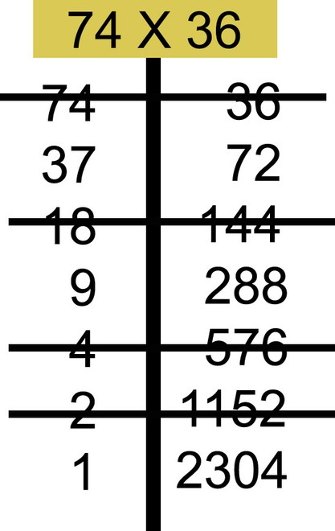
Next, cross out the rows in which the number on the left is even. Extend your line to cross out the corresponding number on the right as well.

Slide 4
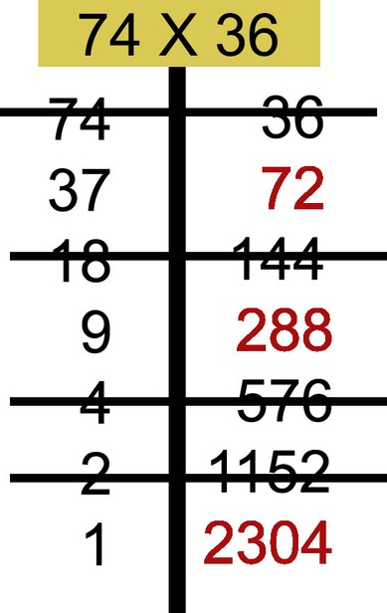
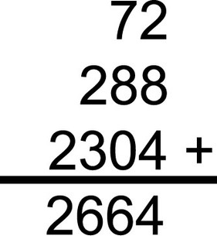
Find the sum of the remaining numbers in the right column. (the numbers in the right column that you did not strike through.) The sum of these numbers is equal to the product you would get from multiplying the original numbers using the standard method.

Slide 5
The code
x = int(input("What is the first number? "))
y = int(input("What is the second number? "))
answer = 0
while y != 0:
if y % 2 != 0:
answer = answer + x
x = x * 2
y = y // 2
if y % 2 == 0:
x = x * 2
y = y // 2
print("the product is", answer)

Slide 6
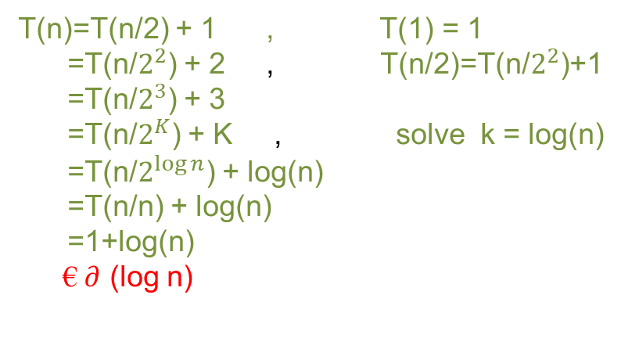
The analysis
Time Complexity:
T(n)=T(n/2) + 1 , T(1) = 1
=T(n/$2^{2}$) + 2 , T(n/2)=T(n/$2^{2}$)+1
=T(n/$2^{3}$) + 3
=T(n/$2^{K}$) + K , solve k = log(n)
=T(n/$2^{log⁡n}$) + log(n)
=T(n/n) + log(n)
=1+log(n)
€ $∂$ (log n)

Slide 7
Thanks!

